Slide 1
Python for Data Analytics
Workshop
Thomas Harvey-Ball
Lecturer in Mathematics
Jason Laurie
Lecturer in Mathematics

Slide 2
Python Workshop Series
Employability
Produce a series of workshops to enhance our students’ employability prospects
Python, Excel, LaTeX, MATLAB,…any other suggestions would be helpful
The Python workshop series
An email announcement will be made after this session
Python for Data Analytics
Wednesday 26th February 2020 14:00-17:00 in MB373

Slide 3
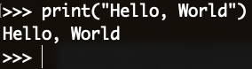
What is Python
Python is a modern, general-purpose, high-level programming language
Clean and simple
Dynamically typed
Automatic memory management
Interpreted
Two version: Python2 and Python3
Advantages
Easy to code and well designed
Documentation is tightly integrated with the code
Large standard library and a large collection of packages
“Hello World” in Python

Slide 4
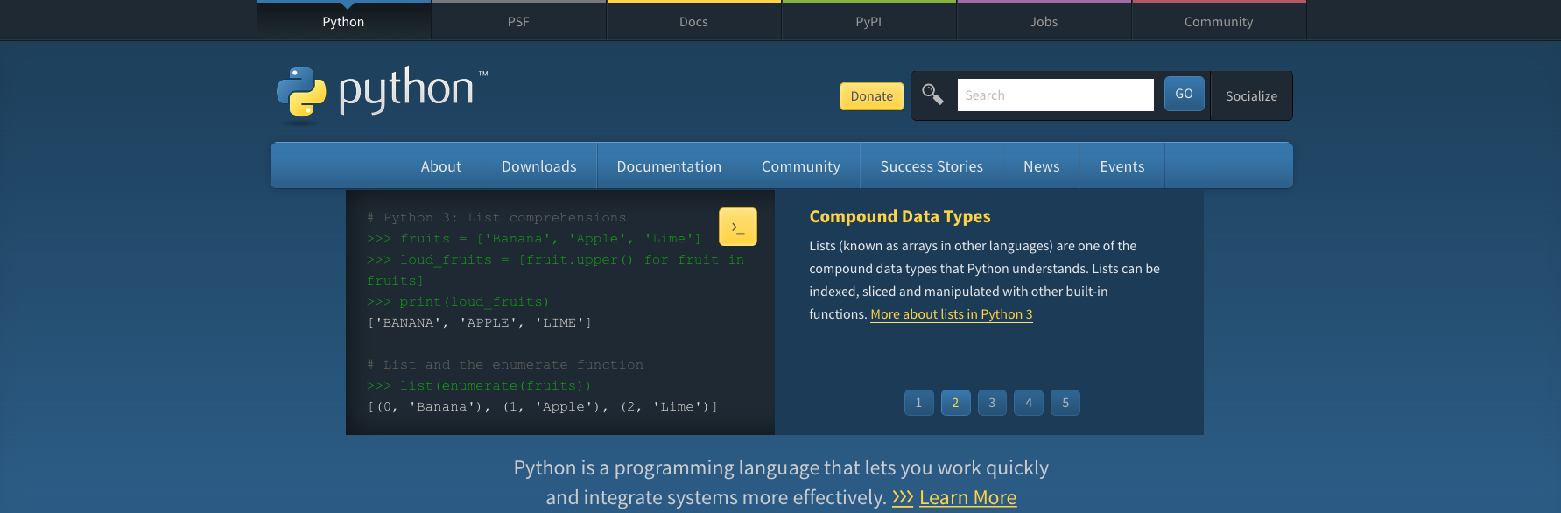

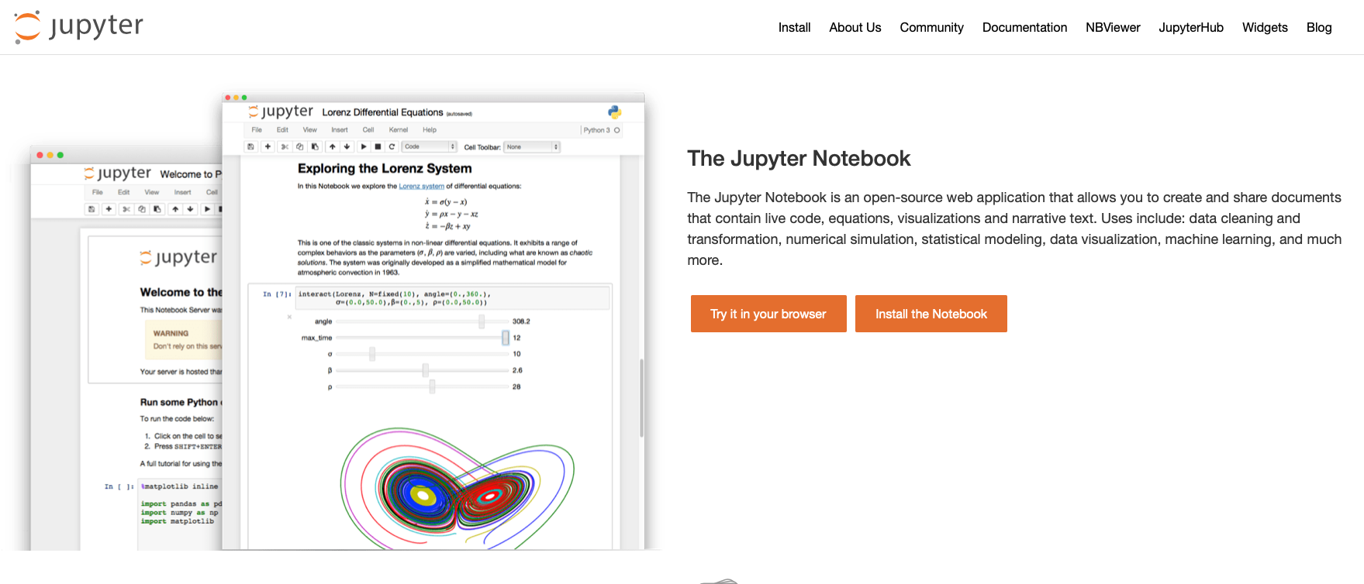
How to use Python
Install Python
www.python.org
Installation guide depending on OS (Windows, MacOS, Linux)
How to run Python code
Python interpreter:
IPython/Jupyter notebooks: www.jupyter.org
we will be using a Jupyter notebook in today’s workshop

Slide 5
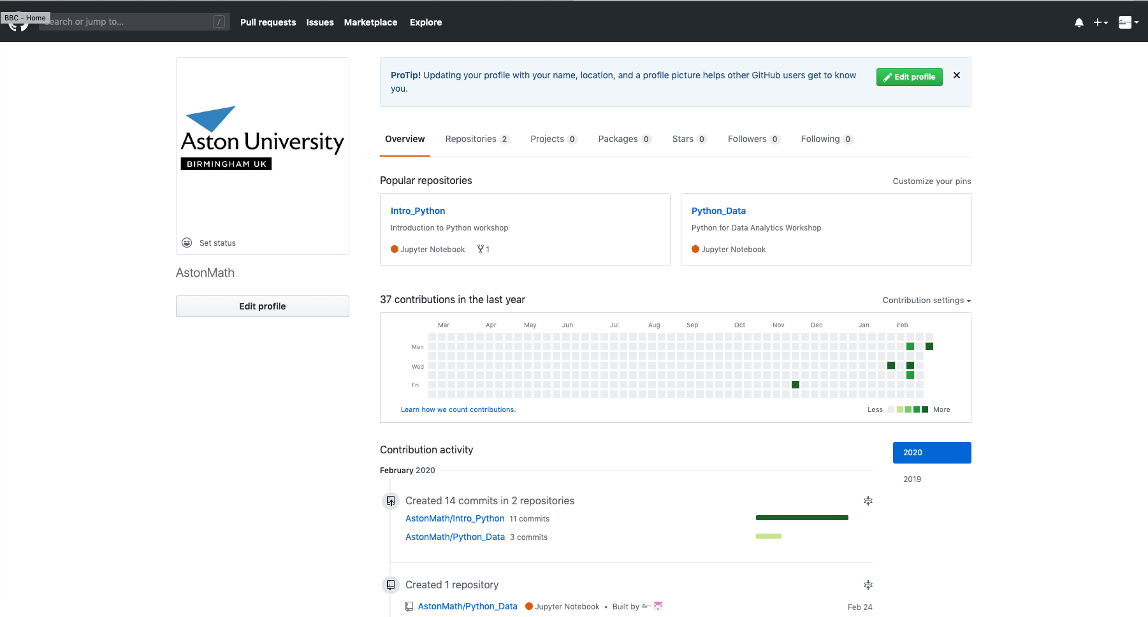
How to Access Today’s Workshop
All of our workshops will be on our GitHub page www.github.com/AstonMath

Slide 6
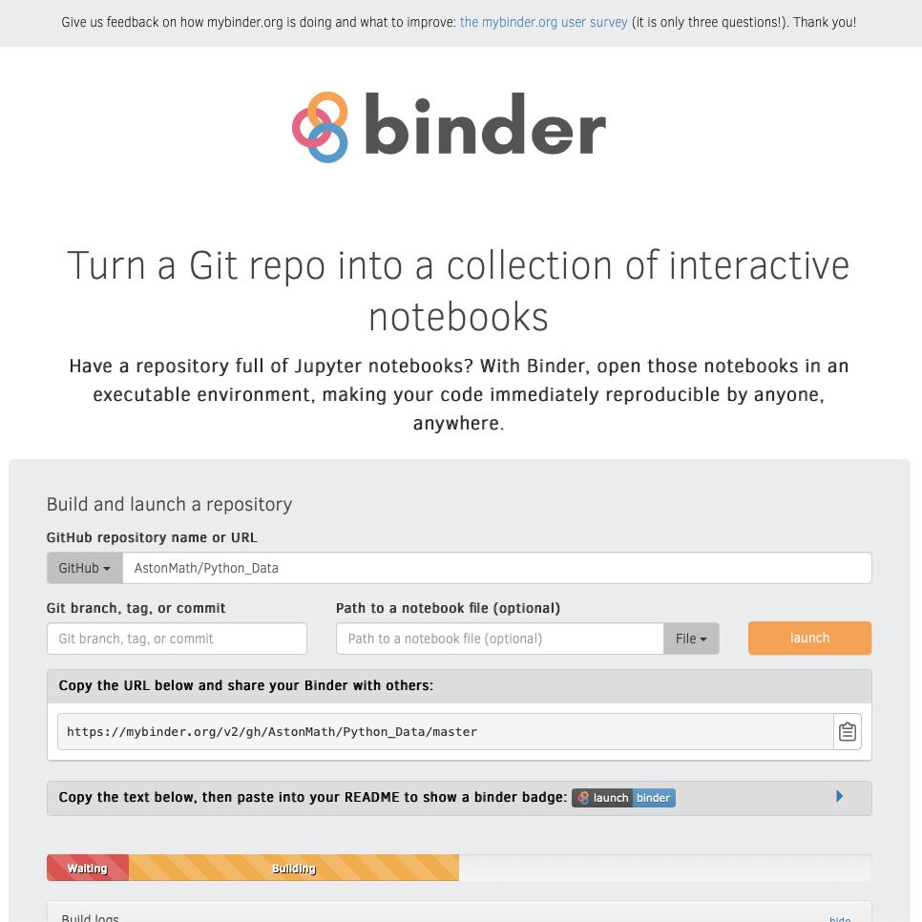
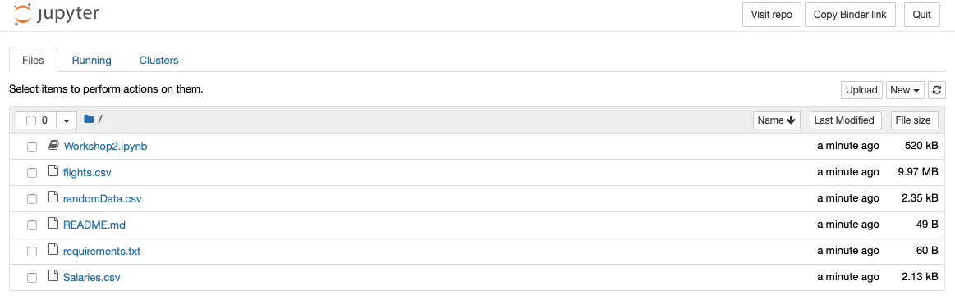
How to Access Today’s Workshop
Go to www.mybinder.org
Add “AstonMath/Python_Data” to the Github repository name box
Click “launch”
Wait…
Click on the notebook “Workshop2.ipynb

Slide 7
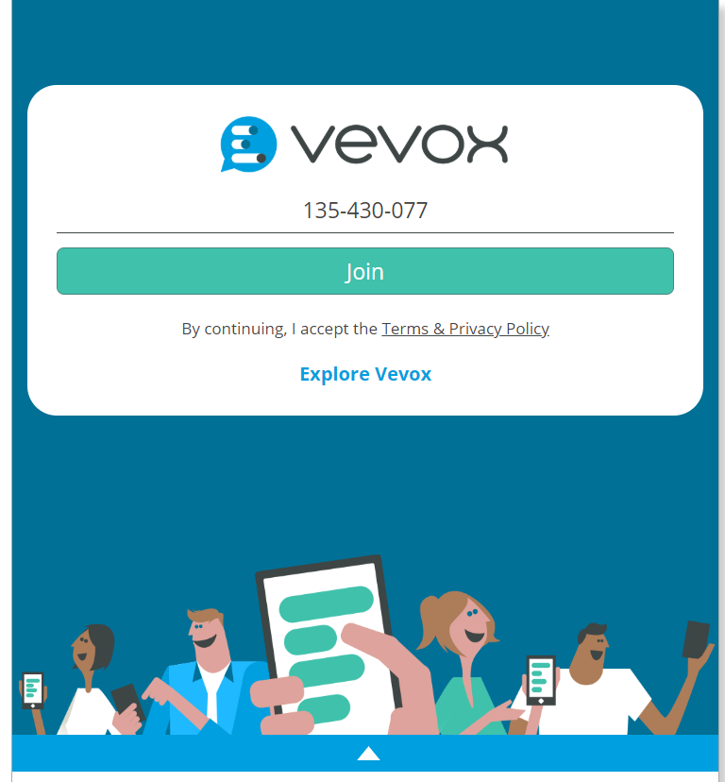
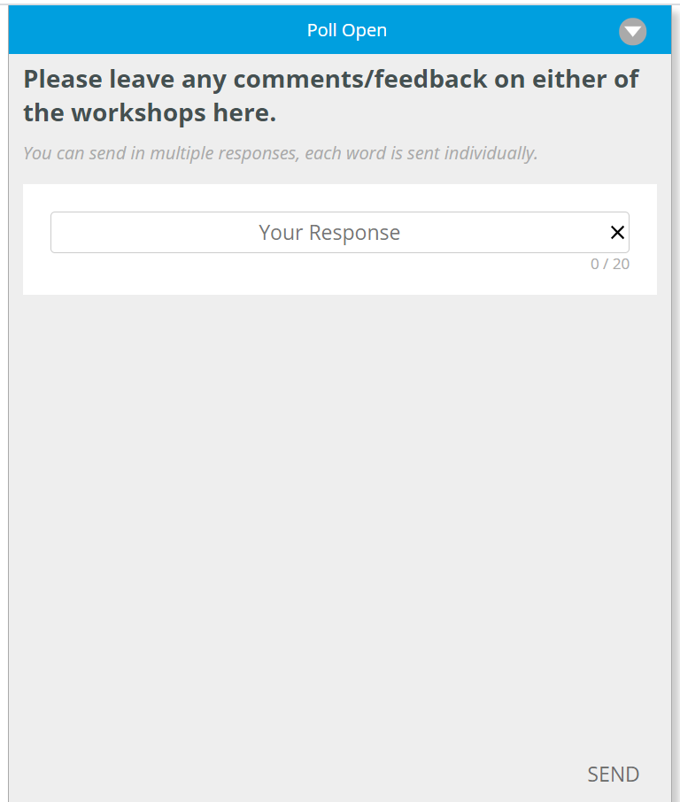
Feedback on these workshops
After today’s session, please help us improve for next time by leaving us your comments/suggestions.
Go to vevox.app in any browser and use the meeting code 135-430-077

